Slide 1


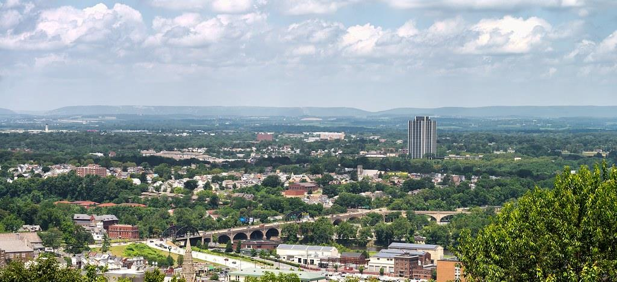
DIRECT-TO-EMPLOYER PLAN
September 25, 2024

Slide 2
Steps to Modeling SLUHN DTE Projections
Identify commercial margin for SLUHN (slides 3-6)
Identify current market share for SLUHN (slide 7)
Estimate PMPY projected healthcare spend (slide 8)
Estimate likely tier-1 with-in DTE steerage (slide 9)
Estimate differences in revenue and profitability for a cohort of 5,000 members (1) on traditional commercial plans and (2) within the DTE (slide 10)
Estimate high and low estimates in revenue and profitability based DTE plan size and varied assumptions (slides 11-17)
Estimate total addressable DTE market and the plan’s 25-year growth path (slide 18)
Estimate plan size and profitability for the first four years (slide 19)
Estimate 25-year revenue growth and profitability (slide 20)

Slide 3
Hospital Metrics | Hospital Metrics | Hospital Metrics | Hospital Metrics | Hospital Metrics | Hospital Metrics | Hospital Metrics | Hospital Metrics
Metric | St Luke's Hospital Bethlehem | St Luke's Hospital - Anderson Campus | St. Luke's Upper Bucks Campus | St Luke's Miners Memorial Hospital | St Luke's Warren Hospital | St Luke's Hospital - Easton Campus | Grand View Hospital
Total Hospital Days | 175,348 | 50,266 | 22,200 | 10,032 | 19,488 | 4,553 | 34,414
Total Medicare Days | 52,829 | 15,729 | 6,831 | 4,324 | 8,271 | 1,739 | 13,584
Total Medicaid Days | 11,581 | 4,726 | 1,513 | 210 | 653 | 139 | 938
Total Other Government Payer Days | 0 | 0 | 0 | 0 | 0 | 0 | 0
Total Inpatient Patient Revenue | $602,108.1K | $191,795.8K | $60,120.5K | $27,847.82K | $63,154.19K | $14,624.38K | $95,947.68K
Total Outpatient Patient Revenue | $613,155.9K | $239,790.1K | $86,069.32K | $79,750.91K | $137,201.8K | $41,012.13K | $140,601K
Total Medicare Revenue | $239,589.9K | $94,531.81K | $34,117.06K | $16,775.95K | $40,371.26K | $8,186.026K | $42,014.48K
Estimated Medicaid and Other Government-Pay Revenue | $136,616.8K | $33,310.48K | $10,636.72K | $12,644.13K | $19,332.77K | $4,531.892K | $8,881.773K
Estimated Commercial Revenue | $839,057.3K | $305,159.9K | $101,702.4K | $78,292.09K | $141,070.3K | $42,705.19K | $185,405.8K
Total Uncompensated Care | $48,987.31K | $14,933.32K | $7,920.645K | $6,751.937K | $3,875.871K | $6,692.891K | $12,862.06K
Estimated Inpatient Costs | $507,803.4K | $152,854.5K | $57,209.3K | $24,434K | $45,493.67K | $13,401.86K | $120,788.3K
Estimated Outpatient Costs | $517,120.8K | $191,104.2K | $81,901.61K | $69,974.36K | $98,834.53K | $37,583.72K | $177,002.2K
Total Operating Expenses | $1,024,924K | $343,958.6K | $139,110.9K | $94,408.36K | $144,328.2K | $50,985.57K | $297,790.4K
Net Income | $190,339.8K | $89,043.57K | $7,345.306K | $13,303.81K | $56,446.17K | $4,437.54K | $-61,488.33K
Estimated Payer Mix Percent Medicare | 30.1% | 31.3% | 30.8% | 43.1% | 42.4% | 38.2% | 39.5%
Estimated Payer Mix Percent Medicaid | 6.6% | 9.4% | 6.8% | 2.1% | 3.4% | 3.1% | 2.7%
Estimated Payer Mix Percent Other Government-Pay | 0.0% | 0.0% | 0.0% | 0.0% | 0.0% | 0.0% | 0.0%
Payer Mix Percent No Pay | 3.9% | 3.3% | 5.1% | 5.9% | 1.9% | 10.7% | 5.2%
Estimated Payer Mix Percent Commercial | 59.4% | 56.0% | 57.3% | 48.9% | 52.3% | 48.0% | 52.6%
Estimated Commercial Profit Margin | 40.2% | 42.9% | 32.4% | 35.7% | 48.4% | 29.5% | 2.0%
1. Most data is taken from the CMS provider cost report. St. Luke’s Carbon Campus is not included in this report as they are currently missing in the Medicare Cost Report. | 1. Most data is taken from the CMS provider cost report | 1. Most data is taken from the CMS provider cost report | 1. Most data is taken from the CMS provider cost report | 1. Most data is taken from the CMS provider cost report | 1. Most data is taken from the CMS provider cost report | 1. Most data is taken from the CMS provider cost report | 1. Most data is taken from the CMS provider cost report
2. Medicare costs are taken from the Medicare Provider Analysis and Review (MedPAR) | 2. Medicare costs are taken from the Medicare Provider Analysis and Review (MedPAR) | 2. Medicare costs are taken from the Medicare Provider Analysis and Review (MedPAR) | 2. Medicare costs are taken from the Medicare Provider Analysis and Review (MedPAR) | 2. Medicare costs are taken from the Medicare Provider Analysis and Review (MedPAR) | 2. Medicare costs are taken from the Medicare Provider Analysis and Review (MedPAR) | 2. Medicare costs are taken from the Medicare Provider Analysis and Review (MedPAR) | 2. Medicare costs are taken from the Medicare Provider Analysis and Review (MedPAR)
3. Data with 'Estimated' in the title are derived from other data points. | 3. Data with 'Estimated' in the title are derived from other data points. | 3. Data with 'Estimated' in the title are derived from other data points. | 3. Data with 'Estimated' in the title are derived from other data points. | 3. Data with 'Estimated' in the title are derived from other data points. | 3. Data with 'Estimated' in the title are derived from other data points. | 3. Data with 'Estimated' in the title are derived from other data points. | 3. Data with 'Estimated' in the title are derived from other data points.
4. Market Share estimates based on total patient revenues with area hospitals. Ambulatory market share based on regional estimates of the percentage of local physicians employed by area hospitals. See Physician Advocacy Institute | 4. Market Share estimates based on total patient revenues with area hospitals. Ambulatory market share based on regional estimates of the percentage of local physicians employed by area hospitals. See Physician Advocacy Institute | 4. Market Share estimates based on total patient revenues with area hospitals. Ambulatory market share based on regional estimates of the percentage of local physicians employed by area hospitals. See Physician Advocacy Institute | 4. Market Share estimates based on total patient revenues with area hospitals. Ambulatory market share based on regional estimates of the percentage of local physicians employed by area hospitals. See Physician Advocacy Institute | 4. Market Share estimates based on total patient revenues with area hospitals. Ambulatory market share based on regional estimates of the percentage of local physicians employed by area hospitals. See Physician Advocacy Institute | 4. Market Share estimates based on total patient revenues with area hospitals. Ambulatory market share based on regional estimates of the percentage of local physicians employed by area hospitals. See Physician Advocacy Institute | 4. Market Share estimates based on total patient revenues with area hospitals. Ambulatory market share based on regional estimates of the percentage of local physicians employed by area hospitals. See Physician Advocacy Institute | 4. Market Share estimates based on total patient revenues with area hospitals. Ambulatory market share based on regional estimates of the percentage of local physicians employed by area hospitals. See Physician Advocacy Institute

Slide 4
Estimation of SLUHN’s 2021 Payer Mix
Payer Group | Total Inpatient Days | Revenue | Payer Mix
All SLUHN | 316,301 | $2,393,180K | 100%
Medicare | 103,307 | $475,586K | 32%
Medicaid | 19,760 | $225,955K | 6%
Other Government Pay | 0
No-Pay, Charity Care | 12,842 | ($102,024K) | 4%
Commercial/Self Pay | 180,392 | $1,693,393K | 57%
Estimating Payer Mix
Medicare, Medicaid, and other government payer mixes are estimated as the percentage of inpatient days for each group divided by total inpatient days.
No-pay and charity care is estimated as the percentage of no-pay/charity care compared to total overall revenue.
Commercial/self pay is assumed to be the rest of the total payer mix share.
Estimating Total Inpatient Days
Total inpatient days for ‘No Pay’ and ‘Commercial’ are estimated to be the payer mix estimates for “No Pay, Charity Care” and “Commercial/Self Pay” multiplied by the total number of inpatient days.
Values in blue are taken from the 2021 Medicare Provider Cost Report (https://data.cms.gov/provider-compliance/cost-report/hospital-provider-cost-report/data)
Values in yellow are taken from Definitive Healthcare data.
Total Medicare patient revenue is reported by CMS in the Medicare Provider Analysis and Review Report (MedPAR)
In other analysis, the outpatient payer mix is assumed to mirror the inpatient payer mix.

Slide 5
Estimation of Margin for Commercial vs. Government Pay
The RAND data for SLUHN estimates commercial insurance reimbursements at 233% of Medicare Rates
Estimating Commercial Margin
(Calculated through counterfactual of assuming all CMS/Government pay was paying at commercial rates)
Estimating Gov-Pay Margin
(Calculated through counterfactual of assuming all commercial pay was paying at Medicare rate)
Commercial Revenue | $1,693,393K
Gov-pay revenue at 233% current rate | $1,631,785K
Total Revenue | $3,325,178K
Total Costs | $2,095,506K
Net Income | $1,229,671K
 | 37%
Commercial Revenue Divided by 233% | $728,028K
Gov-pay revenue | $701,541K
Total Revenue | $1,429,569K
Total Costs | $2,095,506K
Net Income | $ -665,937K
 | -47%

Slide 6
Modeling Prices and Commercial Margins
KBA recommends targeting KBA DTE prices 10% below commercial rates (resulting in a roughly 10 percentage-point drop in DTE profit).
To compensate for this lower margin, KBA provides the following margin improvements:
Streamlined billing ensures no pre-authorization far friendlier billing practices than commercial insurance.
Patient cards allow patients a no-interest payment option for SLUHN patient-responsibility payments. This card also improves patient steerage towards SLUHN.

Slide 7
Estimating Market Share
Hospital Name | Number of Beds | Inpatient Total Charges | Outpatient Total Charges | Inpatient Percent of Market Total | Outpatient Percent of Market Total (Assuming 56.1% of Physicians Employed by Hospitals)
St Luke's Warren Hospital | 92 | $ 464,369.1K | $1,008,837.0K | 2% | 2%
St. Luke's Upper Bucks Campus | 86 | $ 522,787.0K | $ 748,428.8K | 2% | 1%
St Luke's Hospital Bethlehem | 783 | $4,431,459.5K | $4,512,769.9K | 19% | 8%
Grand View Hospital | 180 | $ 313,554.5K | $ 459,480.3K | 1% | 1%
St Luke's Hospital - Easton Campus | 29 | $ 113,367.3K | $ 317,923.5K | 1% | 1%
St Luke's Miners Memorial Hospital | 49 | $ 149,719.5K | $ 428,768.3K | 1% | 1%
St Luke's Hospital - Anderson Campus | 193 | $1,295,917.8K | $1,620,203.3K | 6% | 3%
OSF Holy Family Medical Center | 15 | $ 7,959.6K | $ 107,751.2K | 0% | 0%
Ascension St Vincent Williamsport (FKA St Vincent Williamsport Hospital) | 16 | $ 10,559.8K | $ 84,780.5K | 0% | 0%
The Medical Center at Bowling Green | 318 | $ 803,256.9K | $ 666,736.1K | 4% | 1%
TriStar Greenview Regional Hospital | 118 | $ 428,341.9K | $ 641,858.8K | 2% | 1%
Merit Health River Region (FKA River Region Health System) | 155 | $ 648,085.0K | $ 492,123.8K | 3% | 1%
Beartooth Billings Clinic | 10 | $ 6,596.1K | $ 24,644.3K | 0% | 0%
Hunterdon Health (FKA Hunterdon Medical Center) | 184 | $ 393,935.6K | $ 929,836.7K | 2% | 2%
Hackettstown Medical Center | 95 | $ 419,072.8K | $ 451,745.3K | 2% | 1%
Glens Falls Hospital | 391 | $ 378,756.5K | $ 714,562.5K | 2% | 1%
Atrium Medical Center | 244 | $ 563,010.9K | $ 556,450.0K | 2% | 1%
Lehigh Valley Hospital - Schuylkill S Jackson Street | 118 | $ 244,006.4K | $ 346,134.4K | 1% | 1%
Lehigh Valley Hospital - Schuylkill E Norwegian Street | 99 | $ 117,895.3K | $ 181,742.1K | 1% | 0%
Lower Bucks Hospital | 105 | $ 216,227.2K | $ 126,832.8K | 1% | 0%
Lehigh Valley Hospital - Cedar Crest | 1,190 | $6,447,851.8K | $8,433,644.8K | 28% | 15%
Wilkes-Barre General Hospital | 188 | $ 764,343.4K | $1,091,258.7K | 3% | 2%
Warren General Hospital | 85 | $ 63,831.1K | $ 207,521.0K | 0% | 0%
Lehigh Valley Hospital - Hazleton | 134 | $ 263,046.6K | $ 605,706.7K | 1% | 1%
St Lukes Lehighton Campus | 68 | $ 193,471.3K | $ 288,155.6K | 1% | 1%
Doylestown Hospital (AKA Doylestown Health) | 217 | $ 593,232.7K | $ 853,288.6K | 3% | 2%
Geisinger Wyoming Valley Medical Center | 583 | $2,190,243.6K | $4,045,390.9K | 10% | 7%
Rothman Orthopaedic Specialty Hospital | 24 | $ 63,808.3K | $ 209,522.8K | 0% | 0%
Geisinger St Lukes Hospital | 60 | $ 184,744.4K | $ 275,367.2K | 1% | 0%
St Lukes Carbon Campus | 52 | $ 307,695.2K | $ 371,559.4K | 1% | 1%
Ascension Saint Thomas River Park (FKA River Park Hospital) | 56 | $ 97,845.5K | $ 245,030.4K | 0% | 0%
Castleview Hospital | 39 | $ 63,429.8K | $ 221,776.7K | 0% | 0%
Warren Memorial Hospital | 36 | $ 46,268.2K | $ 194,670.3K | 0% | 0%
Memorial Hospital of Carbon County | 25 | $ 9,924.9K | $ 50,036.4K | 0% | 0%
St. Luke’s Carbon Campus is not included in this report as they are currently missing in the Medicare Cost Report.
For outpatient market share, it is estimated that only 56.1% of local physicians are employed by area hospitals (Research from the Physician Advocacy Institute: https://www.physiciansadvocacyinstitute.org/Portals/0/assets/docs/PAI-Research/PAI-Avalere%20Physician%20Employment%20Trends%20Study%202019-2023%20Final.pdf?ver=uGHF46u1GSeZgYXMKFyYvw%3d%3d)

Slide 8
Estimating PMPY Spend (KBA Data)
Category | Standardized Allowed Charges | Standardized Paid Charges | Member Years | Nationwide Average of Paid Claims | Adjusted to Bethlehem, PA Healthcare Rates
Inpatient | $ 561,766,609 | $ 358,815,229 | 105,492 | $ 3,401 | $ 3,939
OutPatient | $ 1,223,989,466 | $ 652,333,702 |  | $ 6,184 | $ 6,616
Professional | $ 549,353,224 | $ 304,634,120 |  | $ 2,888 | $ 3,089
KBA utilizes its data warehouse with greater than $3B in yearly adjudicated charges to estimate PMPY spend by inpatient, outpatient and professional charges. Pharmacy and non-health-system charges are excluded.
Using the Milliman area adjustment factors by zip code, charges are standardized to local estimates.
These estimated charges are conservative as KBA claims average ~15% below the market average.

Slide 9
Estimating Expected Steerage (KBA Data)
 | DTE Health Plan Tier 1 Utilization – Q1 2024
 | Charges | % | Paid | % | Discount Equivalent
 |  |  |  |  | Charge to Paid
Tier 1 |  | 81.26% |  | 77.42%
Current DTE Network #1 | $ 17,913,805.69 | 54.82% | $ 6,907,327.88 | 58.63% | -61.44%
Current DTE Network #2 | $ 8,460,570.40 | 78.37% | $ 3,280,571.45 | 77.62% | -61.23%
Current DTE Network #3 | $ 629,748.27 | 72.98% | $ 198,216.95 | 80.64% | -68.52%
Current DTE Network #4 | $ 58,261,069.02 | 96.15% | $ 12,968,046.77 | 93.20% | -77.74%
 | $ 85,265,193.38 |  | $ 23,354,163.05
DTE Steerage Impact on an EPO Plan Structure

Slide 10
Pre-DTE Cohort of 5,000 Members | Inpatient | Outpatient | Professional | Total
Revenue† | $ 5,813,802 | $ 5,356,579 | $ 2,500,978 | $ 13,671,359
Net Income‡ | $ 1,505,901 | $ 1,387,470 | $ 647,807.7 | $ 3,541,179
† Assuming proportional revenues from market shares of 32% (inpatient) and 17% (outpatient)
‡ Conservatively assuming a commercial margin of 25.9% (70% of the observed commercial margin)
With DTE | Inpatient | Outpatient | Professional | Total
Revenue⁰ | $ 14,010,150 | $ 25,471,600 | $ 11,892,650 | $ 51,374,400
Net Income* | $ 3,628,933 | $ 6,597,698 | $ 3,080,455 | $ 13,307,085
⁰ Assuming 77% market steerage based on KBA narrow network DTE experience
* Conservatively assuming a commercial margin of 25.9%, with a 10 percentage-point reduction to reflect competitive-edge rates and a 10 percentage-point increase to reflect lower billing costs and better patient-responsibility collections because of the plan patient card.
Total Increase in Net Income | $ 9,765,906
Network Access Fee (Revenue) of $1 PMPM | $ 60,000
Total Profit Growth | $ 9,825,906
Minus Implementation Fee (One-Time) | -$ 150,000
Minus Sales and Marketing (Annual – Ongoing) | -$ 180,000
Total | $ 9,495,906

Slide 11
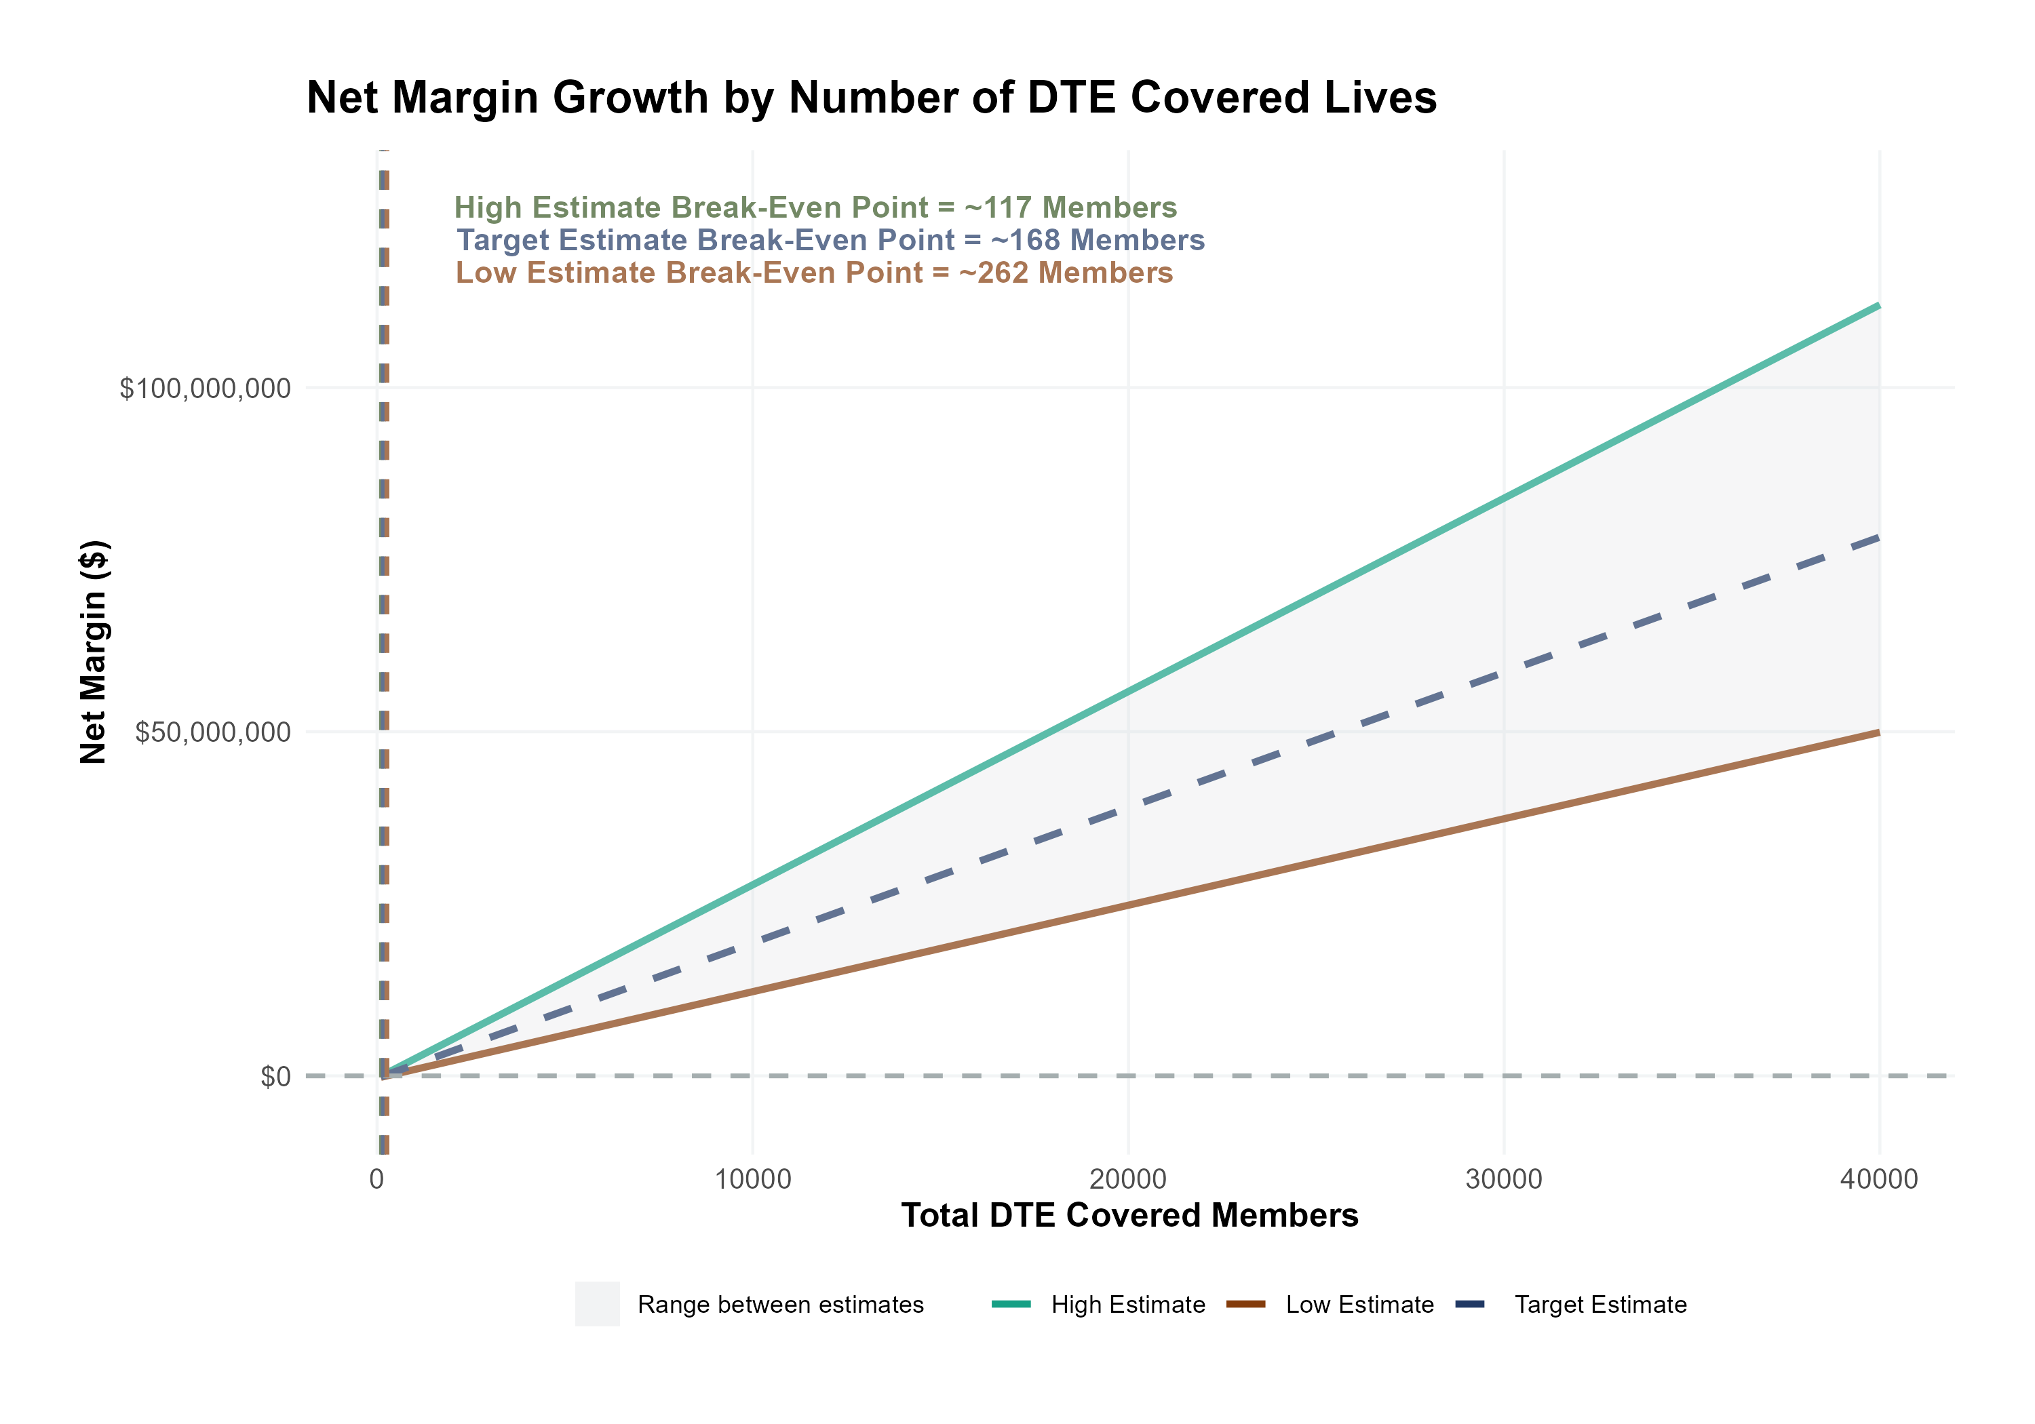
Estimated Financial Returns and Assumptions
Patient Steerage Assumptions
KBA currently estimates that Saint Luke's University Health Network has 32% inpatient market share, and 17% outpatient market compared to hospitals/clinics in the Luzerne, Carbon, Schuylkill, Lehigh, Northampton, Warren, Hunterdon, and Bucks Counties. Based on other KBA DTE networks, we expect steerage to be:
SINGLE-YEAR PROJECTION
Low
Target
High
70%
77%
85%
Commercial Margin Assumptions
KBA estimates DTE margins to be similar to the margin of other commercial plans (prices are lower but billing costs and self-payments are higher). We model DTE commercial margin as on target, below and above other commercial plans.
Low
Target
High
5% Below
Same
5% Above

Slide 12
Target Estimate With a Margin Similar to other Commercial Plans and Target (77%) Patient Steerage | Target estimate with a margin similar to other commercial plans and target (77%) patient steerage. | Target estimate with a margin similar to other commercial plans and target (77%) patient steerage. | Target estimate with a margin similar to other commercial plans and target (77%) patient steerage. | Target estimate with a margin similar to other commercial plans and target (77%) patient steerage.
All values in thousands of dollars | All values in thousands of dollars | All values in thousands of dollars | All values in thousands of dollars | All values in thousands of dollars
Metric | 500 DTE Covered Lives | 1000 DTE Covered Lives | 5000 DTE Covered Lives | 25000 DTE Covered Lives
Pre-DTE Group Total Revenue | $1,367.1 | $2,734.3 | $13,671.4 | $68,356.8
Pre-DTE Group Total Margin | $354.1 | $708.2 | $3,541.2 | $17,705.9
DTE Group Total Revenue | $5,137.4 | $10,274.9 | $51,374.4 | $256,872.0
DTE Group Incremental Total Revenue | $3,770.3 | $7,540.6 | $37,703.0 | $188,515.2
Incremental Total Revenue by Member | $7.5 | $7.5 | $7.5 | $7.5
DTE Group Total Margin | $1,330.7 | $2,661.4 | $13,307.1 | $66,535.4
DTE Group Incremental Total Margin | $976.6 | $1,953.2 | $9,765.9 | $48,829.5
Wellness Share | $6.0 | $12.0 | $60.0 | $300.0
Implementation Fee (One-Time) | $150.0 | $150.0 | $150.0 | $150.0
Sales and Marketing Annual Fee | $180.0 | $180.0 | $180.0 | $180.0
Net Margin Less DTE Fees | $652.6 | $1,635.2 | $9,495.9 | $48,799.5

Slide 13
Target Estimate With a Margin Similar to other Commercial Plans and Target (77%) Patient Steerage | Target estimate with a margin similar to other commercial plans and target (77%) patient steerage. | Target estimate with a margin similar to other commercial plans and target (77%) patient steerage. | Target estimate with a margin similar to other commercial plans and target (77%) patient steerage. | Target estimate with a margin similar to other commercial plans and target (77%) patient steerage.
Estimates by service line, all values in thousands of dollars | All values in thousands of dollars | All values in thousands of dollars | All values in thousands of dollars | All values in thousands of dollars
Metric | 500 DTE Covered Lives | 1000 DTE Covered Lives | 5000 DTE Covered Lives | 25000 DTE Covered Lives
Pre-DTE Group Inpatient Revenue | $581.4 | $1,162.8 | $5,813.8 | $29,069.0
Pre-DTE Group Inpatient Margin | $150.6 | $301.2 | $1,505.9 | $7,529.5
DTE Group Inpatient Revenue | $1,401.0 | $2,802.0 | $14,010.1 | $70,050.8
DTE Group Inpatient Margin | $362.9 | $725.8 | $3,628.9 | $18,144.7
DTE Group Incremental Inpatient Revenue | $819.6 | $1,639.3 | $8,196.3 | $40,981.7
DTE Group Incremental Inpatient Margin | $212.3 | $424.6 | $2,123.0 | $10,615.2
Pre-DTE Group Outpatient Revenue | $535.7 | $1,071.3 | $5,356.6 | $26,782.9
Pre-DTE Group Outpatient Margin | $138.7 | $277.5 | $1,387.5 | $6,937.4
DTE Group Outpatient Revenue | $2,547.2 | $5,094.3 | $25,471.6 | $127,358.0
DTE Group Outpatient Margin | $659.8 | $1,319.5 | $6,597.7 | $32,988.5
DTE Group Incremental Outpatient Revenue | $2,011.5 | $4,023.0 | $20,115.0 | $100,575.1
DTE Group Incremental Outpatient Margin | $521.0 | $1,042.0 | $5,210.2 | $26,051.1
Pre-DTE Group Professional Revenue | $250.1 | $500.2 | $2,501.0 | $12,504.9
Pre-DTE Group Professional Margin | $64.8 | $129.6 | $647.8 | $3,239.0
DTE Group Professional Revenue | $1,189.3 | $2,378.5 | $11,892.6 | $59,463.2
DTE Group Professional Margin | $308.0 | $616.1 | $3,080.5 | $15,402.3
DTE Group Incremental Professional Revenue | $939.2 | $1,878.3 | $9,391.7 | $46,958.4
DTE Group Incremental Professional Margin | $243.3 | $486.5 | $2,432.6 | $12,163.2
Net Margin Less DTE Fees | $652.6 | $1,635.2 | $9,495.9 | $48,799.5

Slide 14
High Estimate With 5 Percentage-Point Margin Improvement Over Commercial Plans and High (85%) Patient Steerage | High estimate with 5 percentage-point margin improvement over commercial plans and high (85%) patient steerage. | High estimate with 5 percentage-point margin improvement over commercial plans and high (85%) patient steerage. | High estimate with 5 percentage-point margin improvement over commercial plans and high (85%) patient steerage. | High estimate with 5 percentage-point margin improvement over commercial plans and high (85%) patient steerage.
All values in thousands of dollars | All values in thousands of dollars | All values in thousands of dollars | All values in thousands of dollars | All values in thousands of dollars
Metric | 500 DTE Covered Lives | 1000 DTE Covered Lives | 5000 DTE Covered Lives | 25000 DTE Covered Lives
Pre-DTE Group Total Revenue | $1,367.1 | $2,734.3 | $13,671.4 | $68,356.8
Pre-DTE Group Total Margin | $354.1 | $708.2 | $3,541.2 | $17,705.9
DTE Group Total Revenue | $5,671.2 | $11,342.4 | $56,712.0 | $283,560.0
DTE Group Incremental Total Revenue | $4,304.1 | $8,608.1 | $43,040.6 | $215,203.2
DTE Group Total Margin | $1,752.5 | $3,505.0 | $17,525.2 | $87,626.2
DTE Group Incremental Total Margin | $1,398.4 | $2,796.8 | $13,984.1 | $69,920.3
Wellness Share | $6.0 | $12.0 | $60.0 | $300.0
Implementation Fee (One-Time) | $150.0 | $150.0 | $150.0 | $150.0
Sales and Marketing Annual Fee | $180.0 | $180.0 | $180.0 | $180.0
Net Margin Less DTE Fees | $1,074.4 | $2,478.8 | $13,714.1 | $69,890.3

Slide 15
High Estimate With 5 Percentage-Point Margin Improvement Over Commercial Plans and High (85%) Patient Steerage | High estimate with 5 percentage-point margin improvement over commercial plans and high (85%) patient steerage. | High estimate with 5 percentage-point margin improvement over commercial plans and high (85%) patient steerage. | High estimate with 5 percentage-point margin improvement over commercial plans and high (85%) patient steerage. | High estimate with 5 percentage-point margin improvement over commercial plans and high (85%) patient steerage.
Estimates by service line, all values in thousands of dollars | All values in thousands of dollars | All values in thousands of dollars | All values in thousands of dollars | All values in thousands of dollars
Metric | 500 DTE Covered Lives | 1000 DTE Covered Lives | 5000 DTE Covered Lives | 25000 DTE Covered Lives
Pre-DTE Group Inpatient Revenue | $581.4 | $1,162.8 | $5,813.8 | $29,069.0
Pre-DTE Group Inpatient Margin | $150.6 | $301.2 | $1,505.9 | $7,529.5
DTE Group Inpatient Revenue | $1,546.6 | $3,093.2 | $15,465.8 | $77,328.8
DTE Group Inpatient Margin | $477.9 | $955.9 | $4,779.3 | $23,896.3
DTE Group Incremental Inpatient Revenue | $965.2 | $1,930.4 | $9,651.9 | $48,259.7
DTE Group Incremental Inpatient Margin | $327.3 | $654.7 | $3,273.4 | $16,366.8
Pre-DTE Group Outpatient Revenue | $535.7 | $1,071.3 | $5,356.6 | $26,782.9
Pre-DTE Group Outpatient Margin | $138.7 | $277.5 | $1,387.5 | $6,937.4
DTE Group Outpatient Revenue | $2,811.8 | $5,623.6 | $28,118.0 | $140,590.0
DTE Group Outpatient Margin | $868.9 | $1,737.8 | $8,689.1 | $43,445.4
DTE Group Incremental Outpatient Revenue | $2,276.1 | $4,552.3 | $22,761.4 | $113,807.1
DTE Group Incremental Outpatient Margin | $730.2 | $1,460.3 | $7,301.6 | $36,508.0
Pre-DTE Group Professional Revenue | $250.1 | $500.2 | $2,501.0 | $12,504.9
Pre-DTE Group Professional Margin | $64.8 | $129.6 | $647.8 | $3,239.0
DTE Group Professional Revenue | $1,312.8 | $2,625.7 | $13,128.2 | $65,641.2
DTE Group Professional Margin | $405.7 | $811.4 | $4,056.9 | $20,284.6
DTE Group Incremental Professional Revenue | $1,062.7 | $2,125.5 | $10,627.3 | $53,136.4
DTE Group Incremental Professional Margin | $340.9 | $681.8 | $3,409.1 | $17,045.5

Slide 16
Low Estimate With 5 Percentage-Point Margin Decrease Over Commercial Plans and Low (70%) Patient Steerage | Low estimate with 5 percentage-point margin decrease over commercial plans and low (70%) patient steerage. | Low estimate with 5 percentage-point margin decrease over commercial plans and low (70%) patient steerage. | Low estimate with 5 percentage-point margin decrease over commercial plans and low (70%) patient steerage. | Low estimate with 5 percentage-point margin decrease over commercial plans and low (70%) patient steerage.
All values in thousands of dollars | All values in thousands of dollars | All values in thousands of dollars | All values in thousands of dollars | All values in thousands of dollars
Metric | 500 DTE Covered Lives | 1000 DTE Covered Lives | 5000 DTE Covered Lives | 25000 DTE Covered Lives
Pre-DTE Group Total Revenue | $1,367.1 | $2,734.3 | $13,671.4 | $68,356.8
Pre-DTE Group Total Margin | $354.1 | $708.2 | $3,541.2 | $17,705.9
DTE Group Total Revenue | $4,670.4 | $9,340.8 | $46,704.0 | $233,520.0
DTE Group Incremental Total Revenue | $3,303.3 | $6,606.5 | $33,032.6 | $165,163.2
DTE Group Total Margin | $976.2 | $1,952.4 | $9,762.2 | $48,810.8
DTE Group Incremental Total Margin | $622.1 | $1,244.2 | $6,221.0 | $31,104.9
Wellness Share | $6.0 | $12.0 | $60.0 | $300.0
Implementation Fee (One-Time) | $150.0 | $150.0 | $150.0 | $150.0
Sales and Marketing Annual Fee | $180.0 | $180.0 | $180.0 | $180.0
Net Margin Less DTE Fees | $298.1 | $926.2 | $5,951.0 | $31,074.9

Slide 17
Low Estimate With 5 Percentage-Point Margin Decrease Over Commercial Plans and Low (70%) Patient Steerage | Low estimate with 5 percentage-point margin decrease over commercial plans and low (70%) patient steerage. | Low estimate with 5 percentage-point margin decrease over commercial plans and low (70%) patient steerage. | Low estimate with 5 percentage-point margin decrease over commercial plans and low (70%) patient steerage. | Low estimate with 5 percentage-point margin decrease over commercial plans and low (70%) patient steerage.
Estimates by service line, all values in thousands of dollars | All values in thousands of dollars | All values in thousands of dollars | All values in thousands of dollars | All values in thousands of dollars
Metric | 500 DTE Covered Lives | 1000 DTE Covered Lives | 5000 DTE Covered Lives | 25000 DTE Covered Lives
Pre-DTE Group Inpatient Revenue | $581.4 | $1,162.8 | $5,813.8 | $29,069.0
Pre-DTE Group Inpatient Margin | $150.6 | $301.2 | $1,505.9 | $7,529.5
DTE Group Inpatient Revenue | $1,273.7 | $2,547.3 | $12,736.5 | $63,682.5
DTE Group Inpatient Margin | $266.2 | $532.4 | $2,662.2 | $13,311.0
DTE Group Incremental Inpatient Revenue | $692.3 | $1,384.5 | $6,922.7 | $34,613.5
DTE Group Incremental Inpatient Margin | $115.6 | $231.3 | $1,156.3 | $5,781.5
Pre-DTE Group Outpatient Revenue | $535.7 | $1,071.3 | $5,356.6 | $26,782.9
Pre-DTE Group Outpatient Margin | $138.7 | $277.5 | $1,387.5 | $6,937.4
DTE Group Outpatient Revenue | $2,315.6 | $4,631.2 | $23,156.0 | $115,780.0
DTE Group Outpatient Margin | $484.0 | $968.0 | $4,840.1 | $24,200.5
DTE Group Incremental Outpatient Revenue | $1,779.9 | $3,559.9 | $17,799.4 | $88,997.1
DTE Group Incremental Outpatient Margin | $345.3 | $690.5 | $3,452.6 | $17,263.2
Pre-DTE Group Professional Revenue | $250.1 | $500.2 | $2,501.0 | $12,504.9
Pre-DTE Group Professional Margin | $64.8 | $129.6 | $647.8 | $3,239.0
DTE Group Professional Revenue | $1,081.2 | $2,162.3 | $10,811.5 | $54,057.5
DTE Group Professional Margin | $226.0 | $452.0 | $2,259.8 | $11,299.2
DTE Group Incremental Professional Revenue | $831.1 | $1,662.1 | $8,310.5 | $41,552.6
DTE Group Incremental Professional Margin | $161.2 | $322.4 | $1,612.0 | $8,060.2

Slide 18
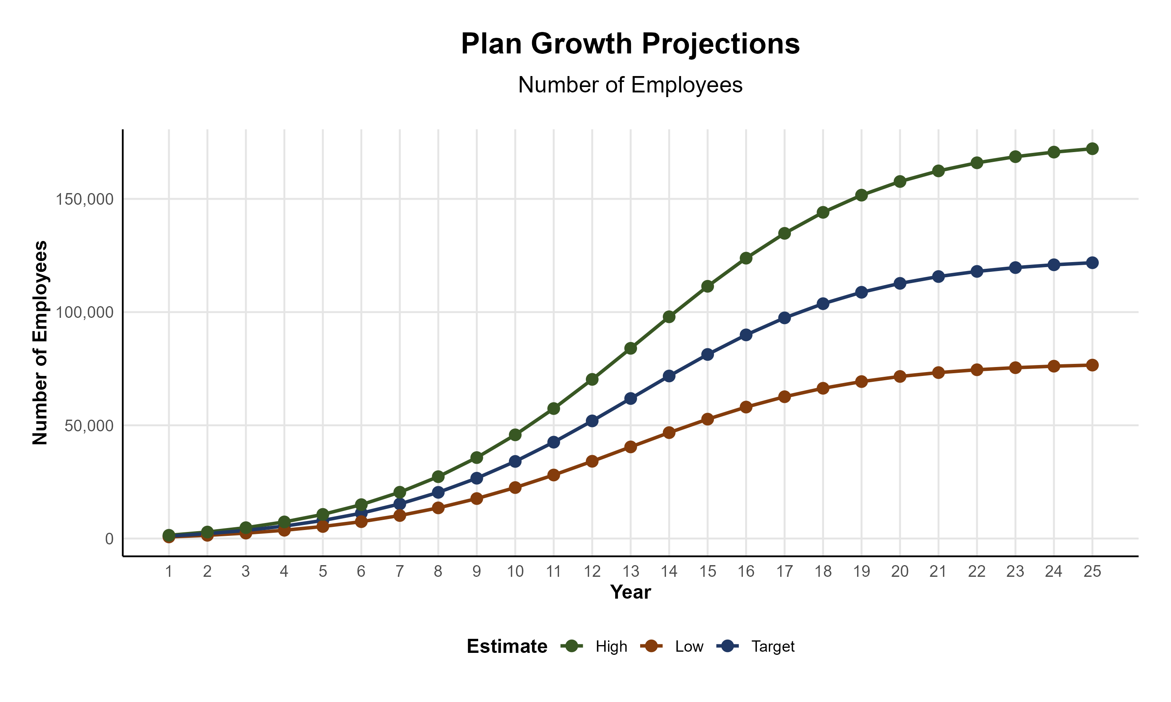
Plan Potential Growth Paths
Self Funded
538K
PLAN GROWTH POTENTIAL
935K
Insured
Working Age
1,230K
Population
2,106K
Estimates include Hunterdon, Warren, Bucks, Carbon, Lehigh, Luzerne, Northampton, and Schuylkill Counties

Slide 19
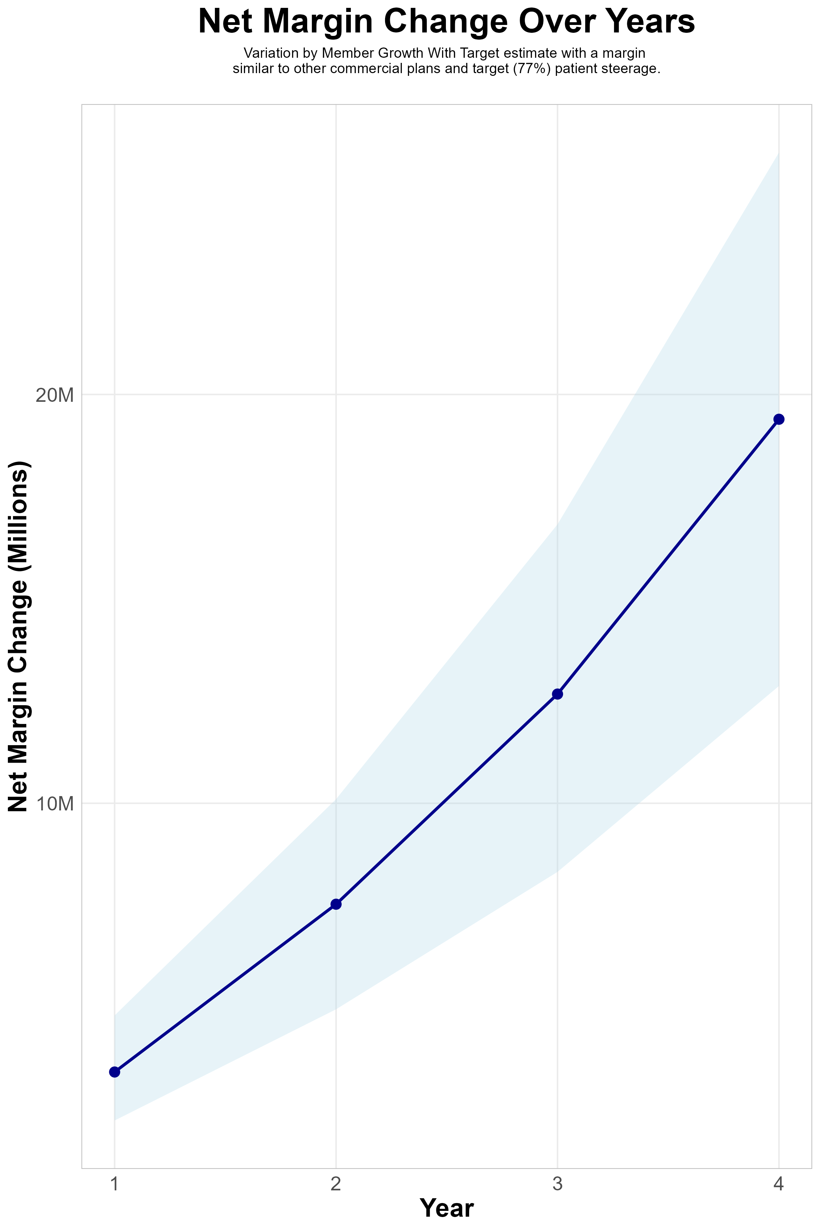
FOUR-YEAR PROJECTIONS
Target Member Growth | Target Member Growth | Target Member Growth | Target Member Growth | Target Member Growth
Metric | Year 1 | Year 2 | Year 3 | Year 4
Number of Members | 1,900 | 3,900 | 6,500 | 9,900
Incremental Margin | 3,733.8K | 7,664.2K | 12,773.7K | 19,455.3K
Network Access Fee | 22.8K | 46.8K | 78.0K | 118.8K
Implementation Fee (One-Time) | -150.0K | 0.0K | 0.0K | 0.0K
Sales and Marketing Costs | -180.0K | -180.0K | -180.0K | -180.0K
Net Margin Change | 3,426.6K | 7,531.0K | 12,671.7K | 19,394.1K
High Member Growth | High Member Growth | High Member Growth | High Member Growth | High Member Growth
Metric | Year 1 | Year 2 | Year 3 | Year 4
Number of Members | 2,600 | 5,200 | 8,600 | 13,200
Incremental Margin | 5,109.5K | 10,218.9K | 16,900.6K | 25,940.4K
Network Access Fee | 31.2K | 62.4K | 103.2K | 158.4K
Implementation Fee (One-Time) | -150.0K | 0.0K | 0.0K | 0.0K
Sales and Marketing Costs | -180.0K | -180.0K | -180.0K | -180.0K
Net Margin Change | 4,810.7K | 10,101.3K | 16,823.8K | 25,918.8K
Low Member Growth | Low Member Growth | Low Member Growth | Low Member Growth | Low Member Growth
Metric | Year 1 | Year 2 | Year 3 | Year 4
Number of Members | 1,300 | 2,600 | 4,300 | 6,600
Incremental Margin | 2,554.7K | 5,109.5K | 8,450.3K | 12,970.2K
Network Access Fee | 15.6K | 31.2K | 51.6K | 79.2K
Implementation Fee (One-Time) | -150.0K | 0.0K | 0.0K | 0.0K
Sales and Marketing Costs | -180.0K | -180.0K | -180.0K | -180.0K
Net Margin Change | 2,240.3K | 4,960.7K | 8,321.9K | 12,869.4K

Slide 20

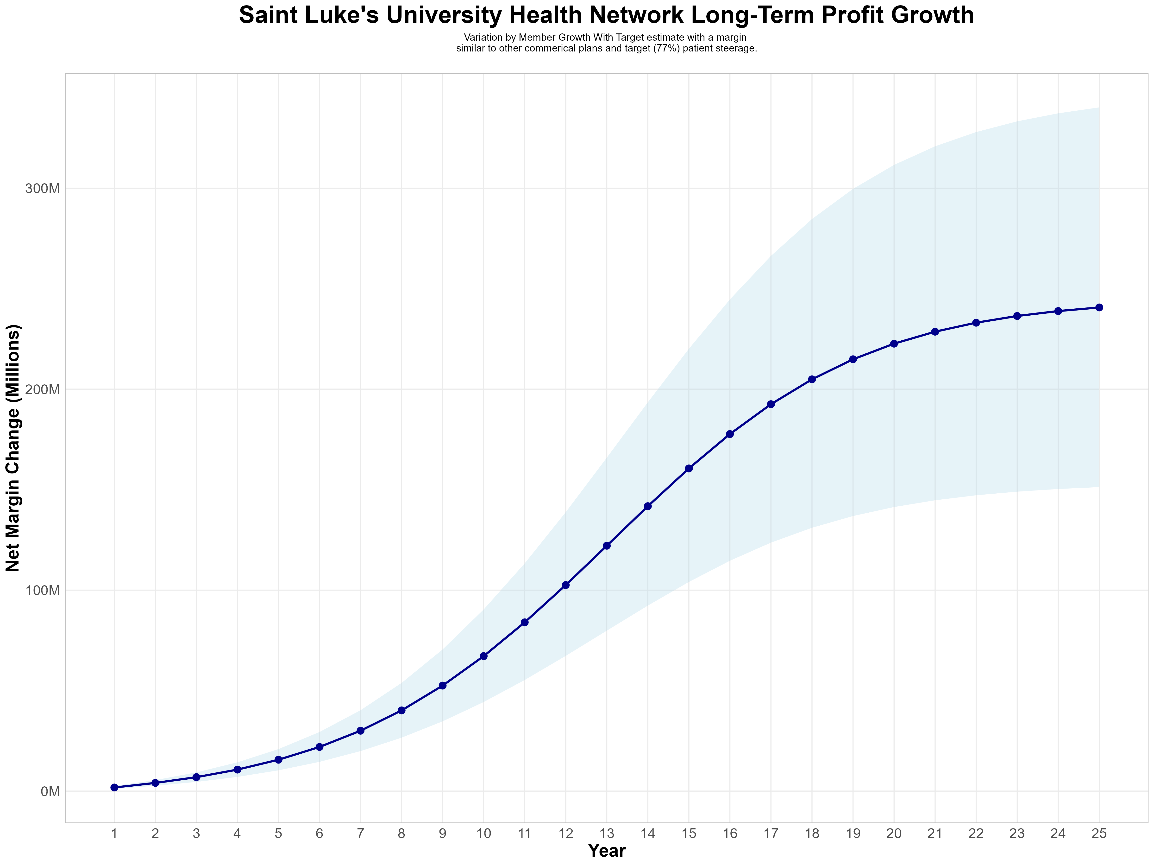
Growing Powerful, Lasting Profitability
Early Stage
Graining Name Recognition, Early Growth
New Revenue:
New Profit:
$63.33M
$16.41M
Growth Stage
Strong Reputation, Strong Growth
New Revenue:
New Profit:
$433.64M
$113.52M
Mature Stage
High Profitability, Market Saturation
New Revenue:
New Profit:
$853.45M
$223.6M

